Slide 1



Business Data Analyst Task Wallex
1
By: Ali Poorabbas
Date: 3/18/2024

Slide 2
Part I: User Behavior
2

Slide 3


User Transaction Description
3
Who?
When?
Crypto Exchange Users: Traders, Spot Investors
Total Users: 1,305
Types: Makers, Takers
Transaction Dates:
Dec 21st 2022 - Feb 20th 2024
Reporting:
March 18th 2024
Markets?
Where?
Total Transaction: 6217
USDT, BTC, SOL, DOGE, ETH
X Exchange

Slide 4
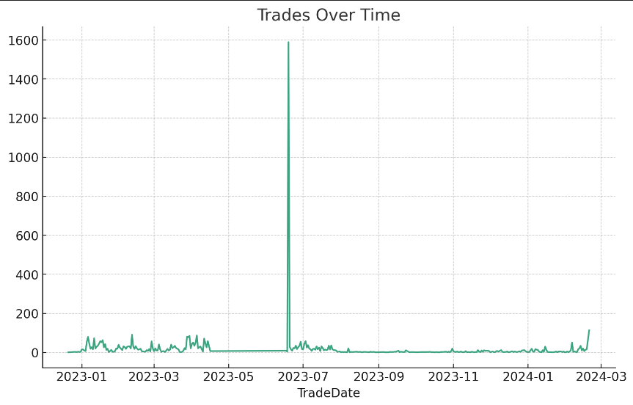
User Transaction Over Time
4

Slide 5
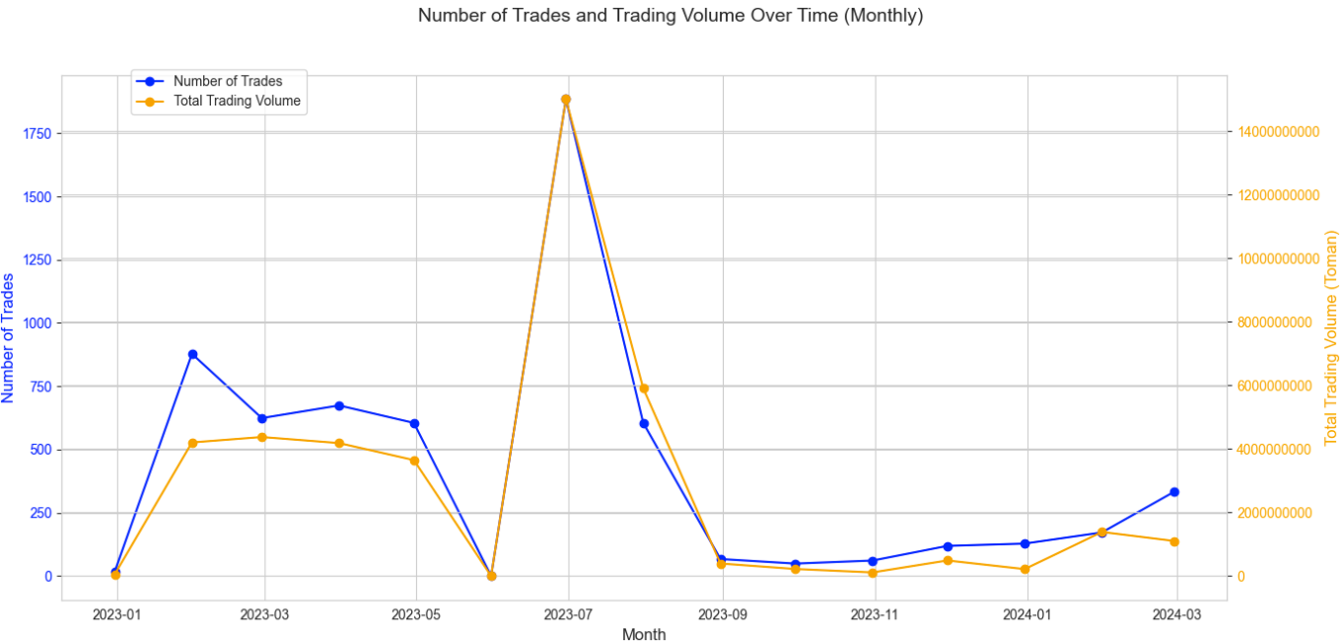
User Transaction Over Time
5

Slide 6
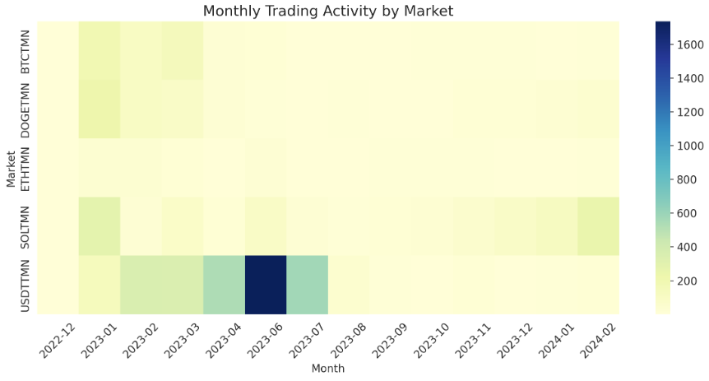
User Transaction Over Time / Market (Heatmap)
6
Trading volumes remained steady from December 2022 to February 2024, with a notable peak in April 2023 within the USDT market. This surge likely reflects a significant event or shift in trader sentiment specific to that market. Other markets showed regular activity without comparable spikes.

Slide 7
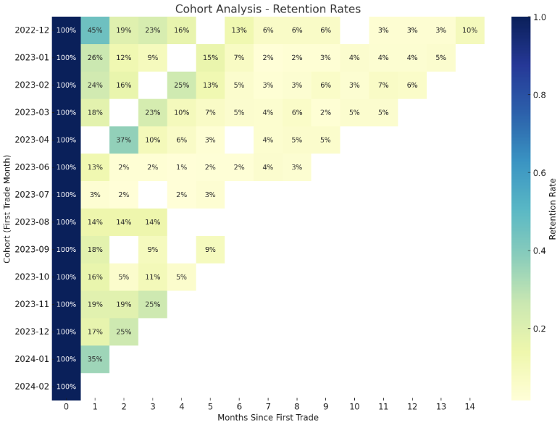
User Retention
7

Slide 8
User Retention Description
8
Cohort Analysis Overview: The chart displays retention rates of users by their first trade month, with a common initial drop-off after the first month.
Notable Patterns:
- The January 2024 cohort shows a notably high second-month retention at 35%, suggesting increased user engagement or improvements in the product/service.
- The April 2023 cohort experiences an increase in the third month to 37%, possibly indicating the impact of a specific event or promotional activity.
- Trend Insights: Later cohorts (from Nov 2023 to Feb 2024) exhibit higher early retention rates compared to earlier ones, hinting at potentially effective changes in retention strategies.
- Key Takeaway: While retention decreases over time, certain cohorts demonstrate higher engagement, indicating opportunities to learn from and replicate successful strategies for future user retention.

Slide 9
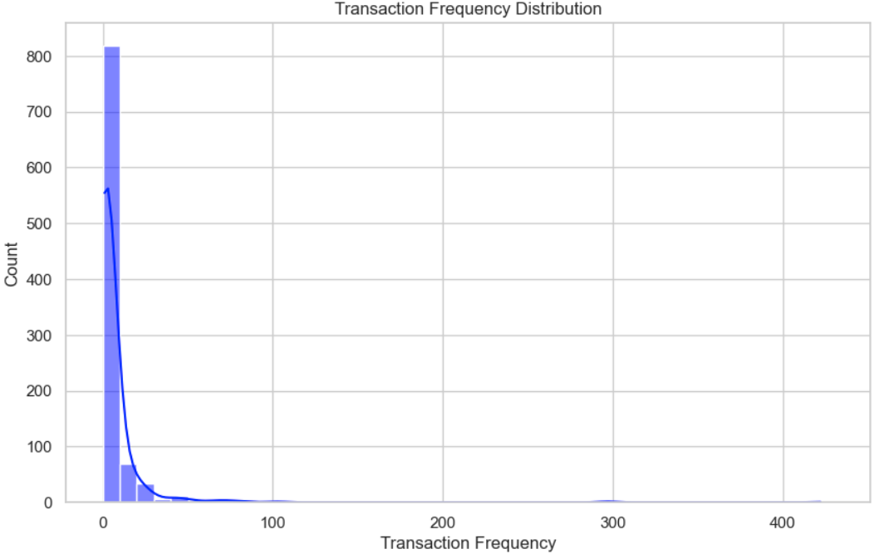
User Transaction Frequency Distribution
9
Total Transactions: 6217
Total Unique Users: 1,305
Average Transactions/User: 6.53
Minimum Transaction/User: 1
Maximum Transaction/User: 422

Slide 10
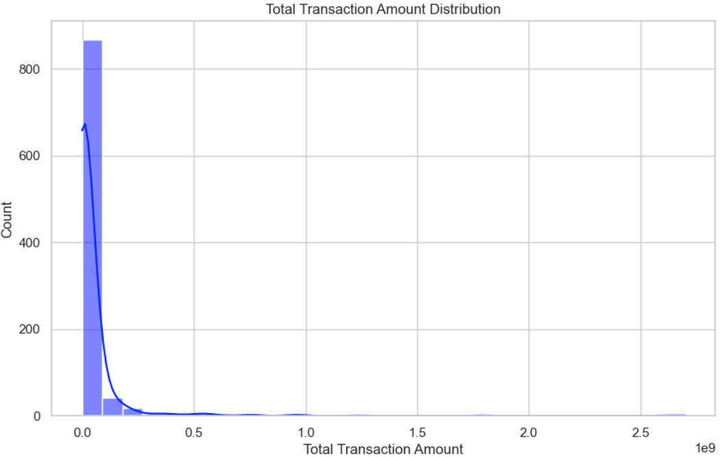
User Transaction Volume Distribution
10
Total Transactions Price Amount: 41,305,840,000
Total Unique Users: 1,305
Average Amount/User: 43,388,480
Minimum Amount/User: 1,736
Maximum Amount/User: 2,700,434,000

Slide 11
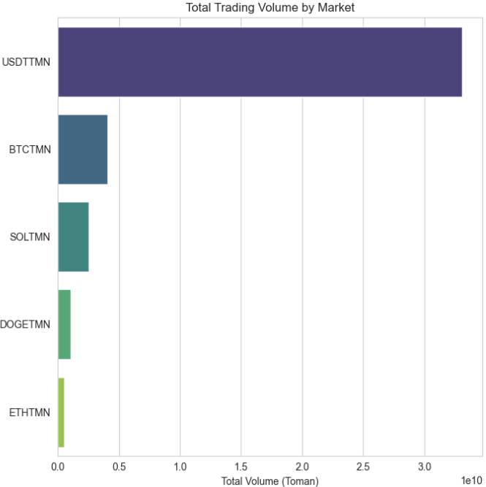
Popular Currencies Among Users | Volume
11
33,118,970,000
4,056,671,000
Total Unique Users: 1,305
Most Volume Market: USDT
2nd Most Volume: BTC
2,548,846,000
1,041,858,000
539,496,400

Slide 12
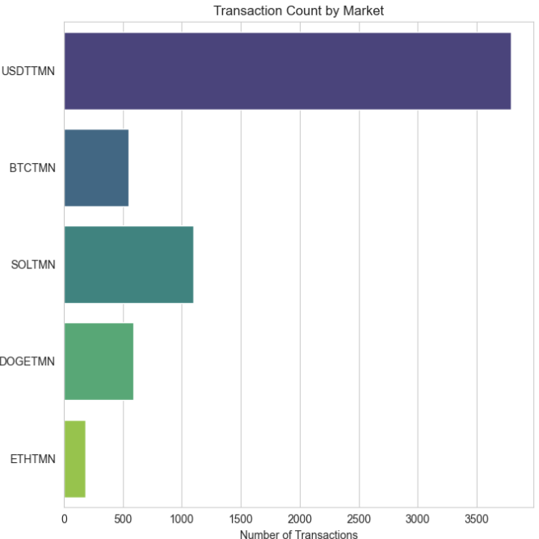
Popular Currencies Among Users | Transaction Frequency
12
3791
Total Unique Users: 1,305
Most Volume Market: USDT
2nd Most Volume: SOL
Notice: Unlike Volume, which had the second rank in BTC, in terms of the number of transactions and frequency, SOL has the second rank in the number of transactions among users.
547
1101
593
185

Slide 13
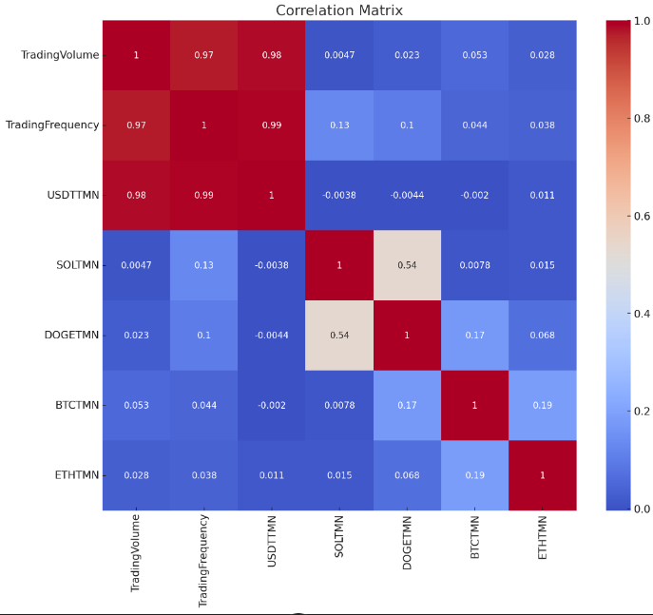
Popular Currencies Among Users | Transaction Frequency
13
1. High Correlation between Trading Volume and Trading Frequency: The matrix shows a very high correlation (0.97 to 0.99) between Trading Volume and Trading Frequency. This indicates that as the volume of trades increases, the frequency of trades also increases. This could be expected as more significant trading activity typically means more transactions are taking place.
2. USDT Markets Correlation: The variables USDT (presumably Tether markets) show a high correlation with both Trading Volume and Trading Frequency (0.98 to 0.99). This suggests that Tether, which is often used as a stablecoin in cryptocurrency markets, is a common medium for traders and may be indicative of liquidity in the market.
3. Moderate Correlation within Specific Coin Markets: There are moderate correlations between some of these markets. For instance, SOL and DOGE have a correlation of 54%, which may suggest that movements in Solana markets have a moderate influence on Dogecoin markets, or vice versa.

Slide 14
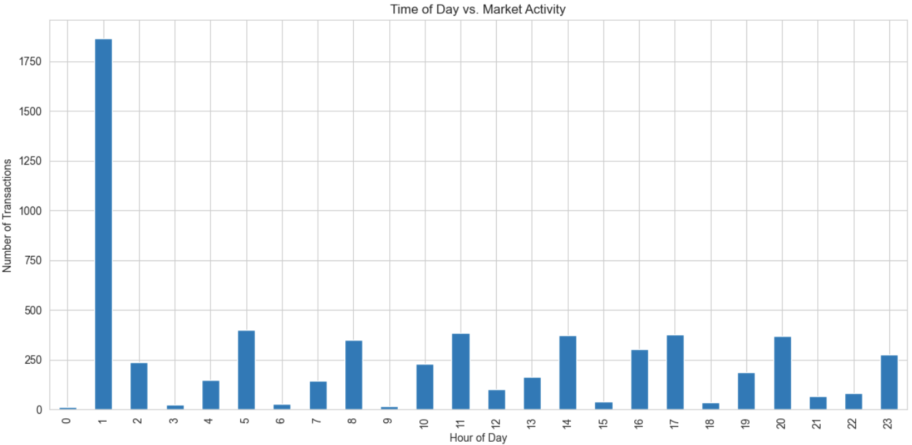
Transaction Timing Patterns by Hour
14
3791
The chart displays a notable peak in transactions at 1 a.m., with lower activity at 5 a.m. Other minor peaks occur at 10 a.m., 3 p.m., and 8 p.m. This suggests strategic times for trading based on varying activity levels throughout the day in a crypto exchange market.

Slide 15
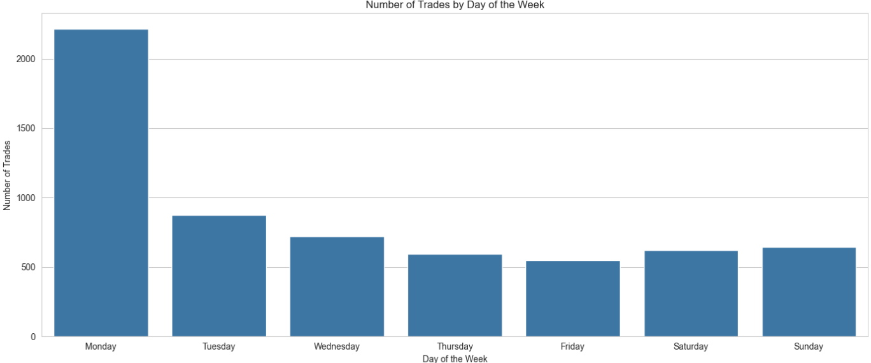
Transaction Timing Patterns by Day of the Week
15
2216
3791
873
721
593
621
642
551
Most transaction day is for Monday that is start of the week and market will be open in this day.

Slide 16
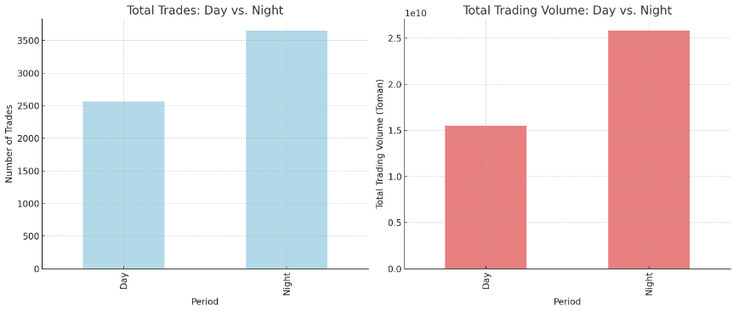
Transaction Timing Patterns by Day of the Week
16
2216
3791
873
721
593
621
642
551
There are more number of trades and more trade volume during the night than during the day.

Slide 17
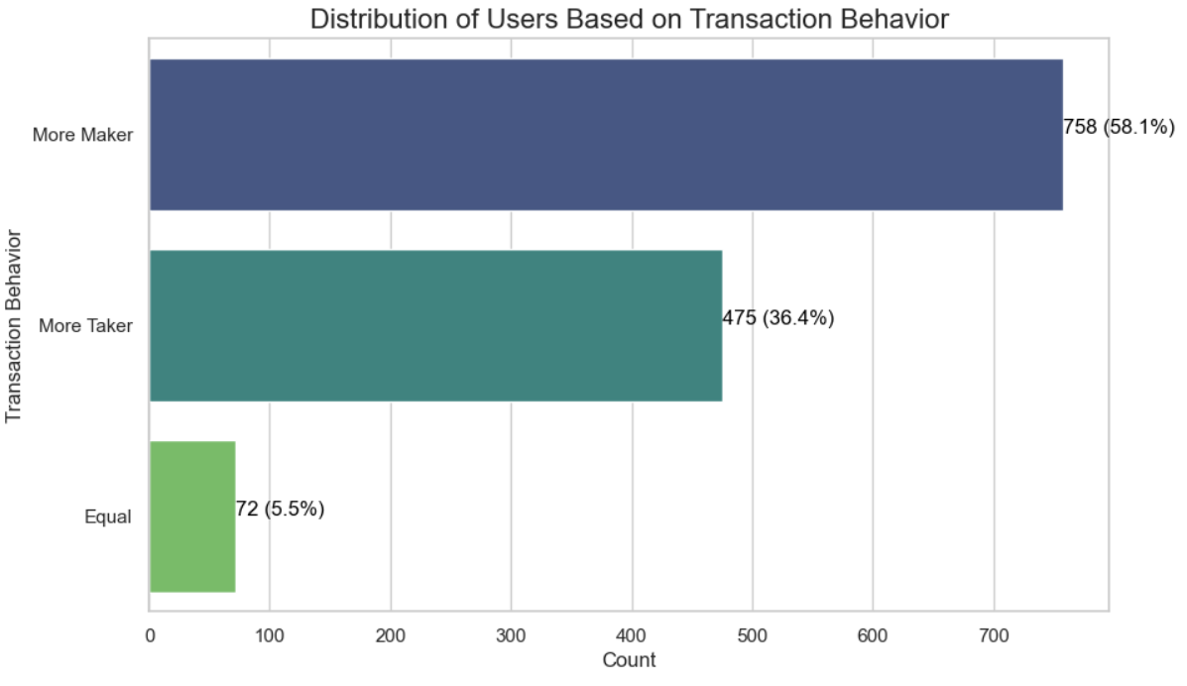
Transaction Behavior Segments
17
3791
"The majority of users fall under the category of 'Makers', indicating a healthier market condition when supply is evenly distributed among them."

Slide 18
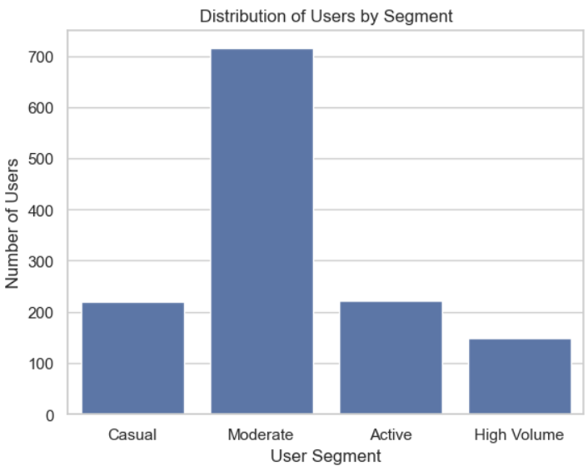
User Segments
18
Casual: Users with low trading volume and a low number of trades.
Moderate: Users with medium trading volume or a moderate number of trades, but not high in both.
Active: Users with high activity in either trading volume or the number of trades but not the highest in both.
High Volume: Users with the highest trading volume and the highest number of trades.
715
220
221
149
Total Unique Users: 1,305

Slide 19
User Segments Description
19
Segmentation Criteria:
- Trading Volume: The total monetary value of trades each user has participated in, both as a Maker and a Taker.
- Number of Trades: The total number of trades each user has made, regardless of their role in those trades.
Segmentation Logic:
1. Quantiles for Trading Volume and Number of Trades:
- The users were first ranked based on their trading volume and number of trades.
- Quantiles (e.g., 20th percentile and 80th percentile) were calculated to understand the distribution and to define thresholds for low, medium, and high levels.
2. Custom Segmentation Formula:
- Casual: Users with trading volume and the number of trades both in the bottom 20% percentile (i.e., lower than both the 20th percentile thresholds of trading volume and number of trades).
- Moderate: Users with trading volume and the number of trades not exceeding the 80th percentile thresholds. This category captures those who are neither in the very low end (Casual) nor in the very high end (Active or High Volume) of activity.
- Active: Users with either trading volume or the number of trades above the 80th percentile but not both. This captures users who are highly active in either volume or frequency but do not top both metrics simultaneously.
- High Volume: Users with both trading volume and the number of trades above the 80th percentile. This segment identifies the most active users in terms of both the monetary value of trades and the frequency of trading activities.

Slide 20
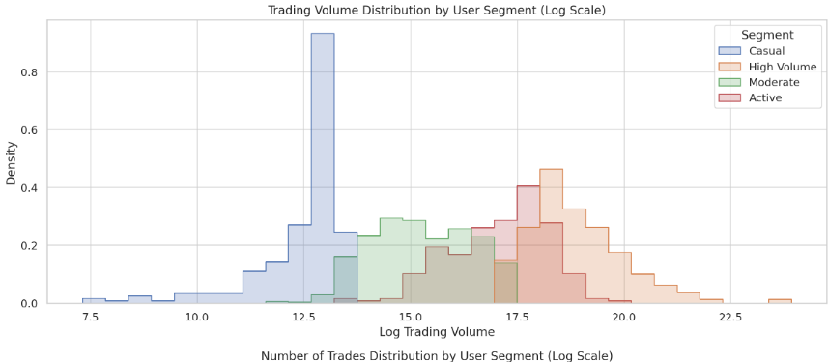
User Transaction Insights
20
"Casual" traders have the lowest range of trading volumes, while "High Volume" traders have a wider distribution, suggesting greater variation in their trading volumes.
"Moderate" and "Active" traders overlap considerably in their trading volumes, indicating similarities in their trading behaviors.

Slide 21
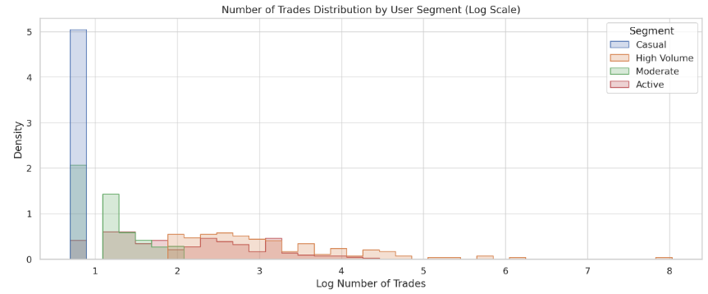
User Transaction Insights
21
Again, "Casual" traders show the lowest range of trades.
"High Volume" traders have a higher number of trades, with some outliers conducting significantly more trades than their peers.

Slide 22
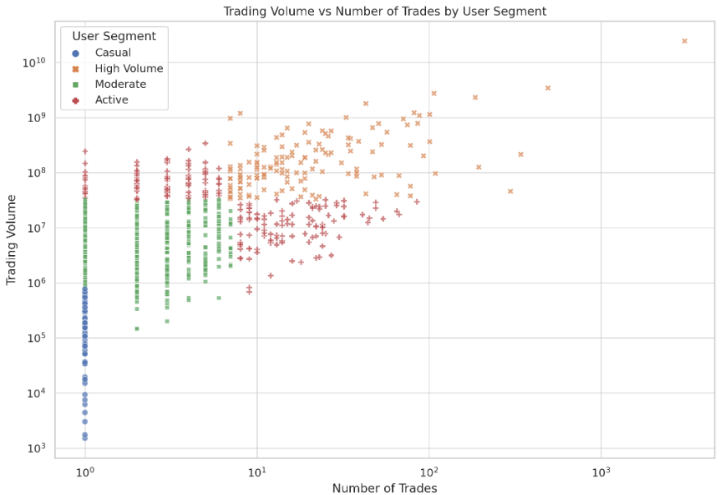
User Transaction Insights
22
"Casual" traders cluster at the lower end of both axes, indicating low trading volume and low numbers of trades.
"High Volume" and "Active" traders are spread out, showing a wide range of both trading volumes and numbers of trades, with "High Volume" traders tending to trade larger amounts.

Slide 23
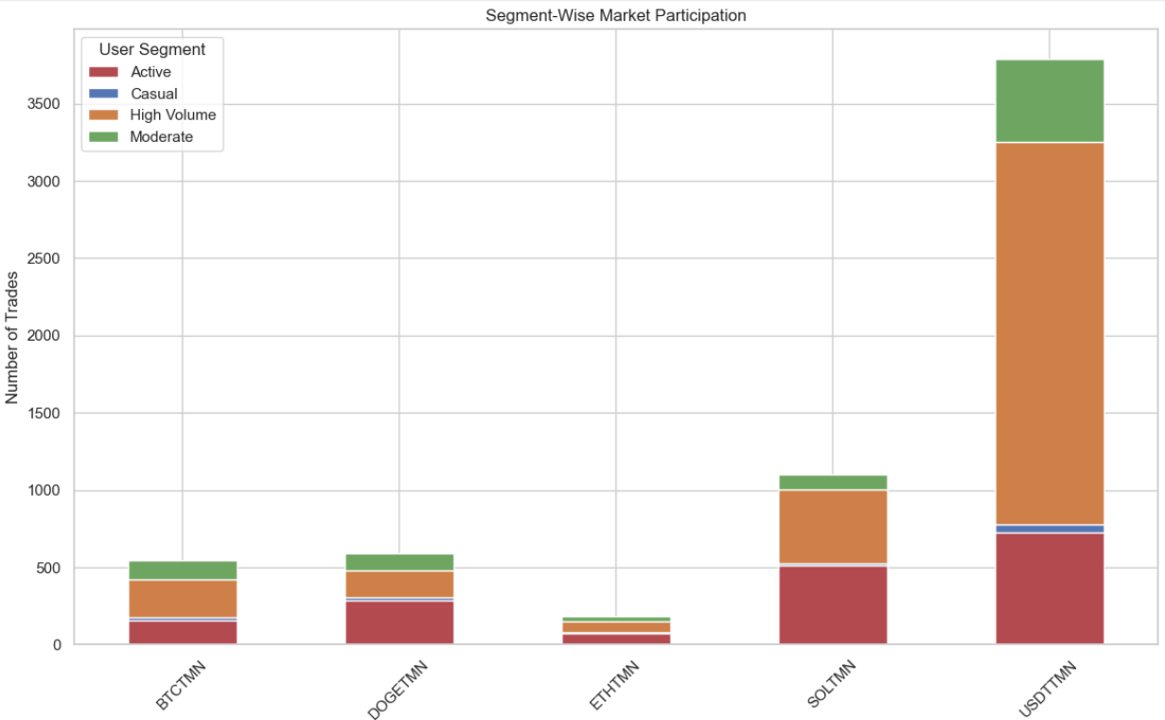
User Transaction Insights
23
"Active" traders are the most involved across all cryptocurrencies, with especially high participation in "USDT" trades.
"Casual" and "Moderate" traders show relatively similar levels of participation across cryptocurrencies, except for "USDT" where "Moderate" traders show a notably higher number of trades.

Slide 24
Part II: Fee Table Optimization
24

Slide 25
Fee Table X vs. Competitor
25
X Exchange Fee Sheet
% Taker Fee | % Maker Fee | Volume
0.25% | 0.20% | Up to 100 Million Toman
0.225% | 0.18% | Up to 500 Million Toman
0.20% | 0.16% | Up to 1 Billion Toman
0.18% | 0.14% | Up to 4 Billion Toman
0.17% | 0.125% | Up to 10 Billion Toman
0.15% | 0.12% | More than 10 Billion Toman
(50%)
Total Revenue: 181,282,127
(25%)
Competitor Exchange Fee Sheet
% Taker Fee | % Maker Fee | Volume
0.25% | 0.20% | Up to 100 Million Toman
0.20% | 0.17% | Up to 300 Million Toman
0.19% | 0.15% | Up to 1 Billion Toman
0.175% | 0.125% | Up to 5 Billion Toman
0.155% | 0.10% | More than 5 Billion Toman
Total Revenue: 177,610,285

Slide 26
Fee Table X vs. Competitor | Difference
26
X Exchange Fee Sheet
X | # of Transaction
Up to 100m | 5624
Up to 500m | 46
Up to 1b | 40
Up to 4b | 506
Up to 10b | 1
More than 10b | 0
Fee Tier | Taker Fee % Difference | Maker Fee % Difference
Up to 100M | 0.00% | 0.00%
Up to 500M/300M | +12.50% | +5.88%
Up to 1B | +5.26% | +6.67%
Up to 4B/5B | +2.86% | +12.00%
> 10B/5B | -3.23% | +20.00%
Difference (Toman) |  | +3,671,842
Competitor Exchange Fee Sheet
Competitor | # of Transaction
Up to 100m | 5624
Up to 300m | 46
Up to 1b | 40
Up to 5b | 507
More than 5b | 0
- | -
Maker Fee Difference: The largest difference is in the highest volume tier ("> 10B/5B"), where Exchange X charges 20.00% more than its competitor.
Taker Fee Difference: The largest difference is in the medium volume tier ("Up to 500M/300M"), where Exchange X charges 12.50% more than its competitor.

Slide 27
Fee Table Optimization | KPI and Metrics
27
Before proposing the optimized fee table, we considered several KPIs and metrics to evaluate the current performance of Exchange X and the potential impact of fee adjustments:
Total Trading Volume: A critical measure of market activity and liquidity, indicating the total value of transactions over a given period. The pre-optimization analysis showed a total trading volume of approximately 41.31 billion Tomans.
Revenue from Fees: This metric reflects the exchange's income from trading fees, crucial for its financial health. Before any optimization, the calculated revenue from fees (using simplified average rates) was approximately 181.28 million Tomans.
Average Transaction Size: Understanding the typical transaction size helps gauge market participation levels and the distribution of trading activity. The average transaction size was calculated to be around 6.64 million Tomans per trade.

Slide 28
Fee Table Optimization | Proposal
28
% Taker Fee | % Maker Fee | Volume
0.24% (-0.01%) | 0.19% (-0.01%) | Up to 100 Million Toman
0.22% (-0.005%) | 0.17% (-0.01%) | Up to 500 Million Toman
0.195% (-0.005%) | 0.15% (-0.01%) | Up to 1 Billion Toman
0.18% (0%) | 0.14% (0%) | Up to 4 Billion Toman
0.165% (-0.005%) | 0.13% (-0.005%) | Up to 10 Billion Toman
0.15% (0%) | 0.12% (0%) | More than 10 Billion Toman
1. Competitive Edge: Adjusting fees makes Exchange X more competitive, especially for high-volume tiers, by undercutting competitors and attracting a wider user base.
Market Maker Incentives: Lowering maker fees promotes liquidity, leading to tighter spreads and a more efficient market, attracting more takers.
Trade-off: Adjusted fees may reduce short-term revenue, but increased volume can compensate, enhancing long-term revenue.
Flexibility: The tiered fee structure allows for adjustments based on market conditions and trading volumes, offering scalability without overhauling the model.

Slide 29
Fee Table X (Optimized) vs. Competitor | Difference
29
X Exchange Fee Sheet
X | # of Transaction
Up to 100m | 5624
Up to 500m | 46
Up to 1b | 40
Up to 4b | 506
Up to 10b | 1
More than 10b | 0
Fee Tier | Taker Fee % Difference | Maker Fee % Difference
Up to 100M | -0.01% | -0.01%
Up to 500M/300M | 0.00% | +0.02%
Up to 1B | 0.00% | +0.005%
Up to 4B/5B | +0.015% | +0.005%
> 10B/5B | +0.03% | +0.01%
Difference (Toman) |  | -4,112,818
Competitor Exchange Fee Sheet
Competitor | # of Transaction
Up to 100m | 5624
Up to 300m | 46
Up to 1b | 40
Up to 5b | 507
More than 5b | 0
- | -
Total Revenue after optimize: 173,497,467
Total Revenue Difference: -0. 042

Slide 30
Fee Table Optimization | Here's why?
30
1. Competitive Positioning
The optimized fee structure is more competitive, especially at higher volume tiers, where it offers noticeably lower fees than both the current Exchange X rates and those of the competitor. This can attract high-volume traders, who are crucial for liquidity and overall market activity.
2. Encouragement of Market Activity
By reducing fees, particularly for makers who add liquidity to the market, the exchange encourages more trading activity. This can lead to an increase in the total number of transactions, potentially compensating for the lower fee rates through volume.
3. Flexibility and Growth
The tiered approach allows for flexibility and accommodates growth. Traders are incentivized to increase their trading volume to benefit from lower fees, aligning their interests with those of the exchange for mutual growth.
4. Adaptability
This structure is adaptable to market changes and competitor moves. It allows Exchange X to adjust specific tiers or rates as needed to remain competitive without overhauling the entire fee structure.
5. Customer Satisfaction
Competitive fees enhance trader satisfaction and loyalty. Satisfied customers are more likely to increase their trading activity and recommend the exchange to others, fostering organic growth.

Slide 31
Part III: Subscription Model
31

Slide 32
Subscription Model | Idea
32
Tier Name | Benefits | Target Segment | Monthly Fee (Example)
Basic | 10% discount on maker and taker fees | Casual and Moderate Users | 500,000 Toman
Pro | 20% discount on maker and taker fees | Active Users | 1,000,000 Toman
Premium | 30% discount on maker and taker fees | High Volume & All Transaction Types | 2,000,000 Toman

Slide 33
Subscription Model | Methodology
33
Subscription Model Estimates:
Estimated Number of Subscribers:
Basic Membership: 36 traders (5% of Moderate users)
Premium Membership: 22 traders (10% of Active users)
Elite Membership: 22 traders (15% of Active users)
Revenue from Subscription Fees:
Total Revenue from Subscription Fees: 83,000,000 Tomans
Revenue from Fees After Subscription Discounts:
New Fee Revenue (After Discounts): Approximately 133,821,931 Tomans
Estimated Total Revenue (Subscription + Fees):
Total Estimated Revenue (After Implementation): Approximately 216,821,931 Tomans
Total Revenue Before Subscription Model: 173,497,467
Total Revenue After Subscription Model: 216,821,931 (+25%)

Slide 34
Subscription Model | Side Effect & Additional Data
34
Possible Side Effects:
Reduced User Base: High membership fees might discourage users, especially low-volume traders, leading to a decrease in overall trading activity and revenue.
Market Competition: Other exchanges with lower fees or free basic services might attract users if Exchange X's membership fees are not competitive.
Negative User Perception: Introducing membership fees might be perceived negatively by users, impacting brand loyalty.
Additional Data for a More Accurate Decision:
User Surveys and Feedback: Understanding user preferences and willingness to pay for specific benefits helps design attractive membership tiers.
Competitor Analysis: Knowing the fee structures and membership programs of competitor exchanges helps determine a competitive pricing strategy.
Historical Data on User Behavior: Analyzing past user behavior (e.g., frequency of trades, average trade size) helps predict how users might respond to different membership options.
Cost of Implementing Memberships: Estimate the cost of developing and managing the membership program to determine potential profitability.

Slide 35
The End Thank you for your Attention
35
By: Ali Poorabbas
Date: 3/18/2024

